Slide 1

Two days workshop on Deep Learning
Under Auspices of Lead India AI
Dr Amita Kapoor
Associate Professor,
Shaheed Rajguru College of Applied Sciences for Women

Slide 2
Yesterday
McCulloch Pitts Model
Single Layer Perceptron
Multi Layered Perceptron

Slide 3
Today
Convolutional Neural Networks

Slide 4
Why Deep Learning
Deep Learning is achieving state-of-the art results across a range of difficult problem domains.
It is about action
Download Tensorflow, Keras and you can build your first neural network model in 5 minutes.
Only using four commands model (add, compile, fit, predict)
Notes:
Magenta
RobotArt: Team TAIDA from National Taiwan University took home the grand prize of $30,000 with their Robot Artist,

Slide 5
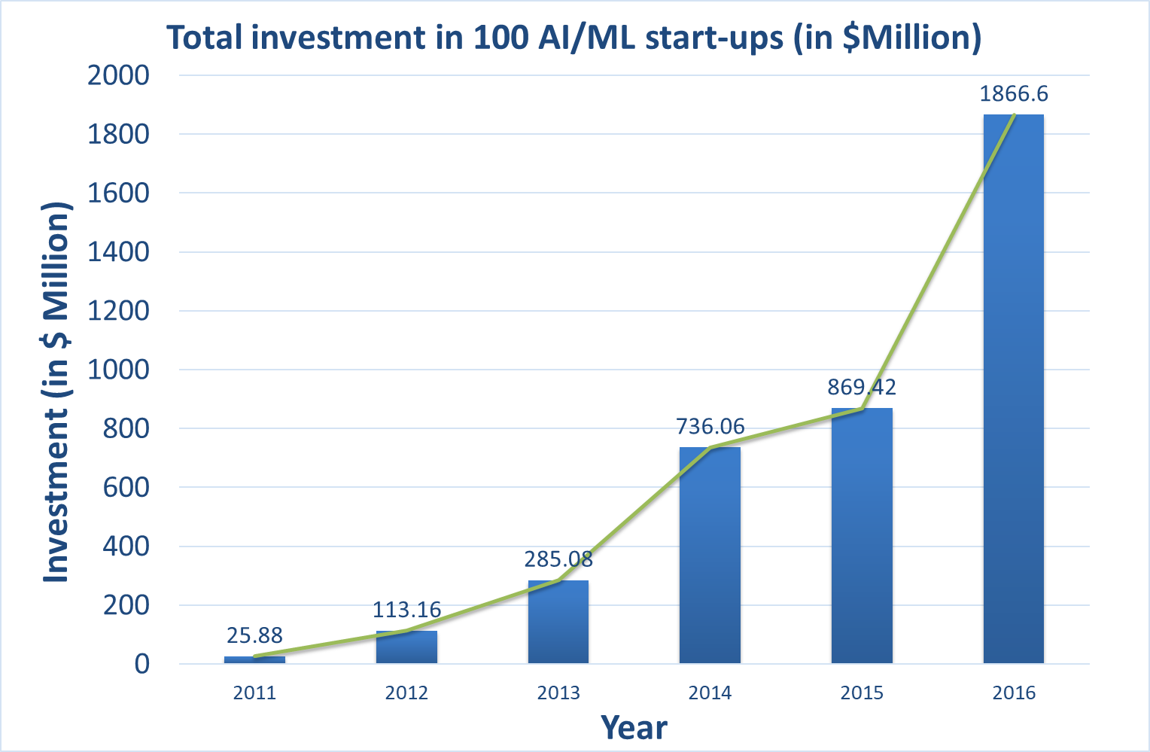
Why ML

Slide 6
Deep Learning: Success Stories
Automatic Colorization of Black and White Images
Automatically Adding Sounds To Silent Movies
Automatic Machine Translation
Object Classification and Detection in Photographs
Automatic Handwriting Generation
Automatic Text Generation
Automatic Image Caption Generation
Automatic Game Playing
Notes:
Generally the approach involves the use of very large convolutional neural networks and supervised layers that recreate the image with the addition of color

Slide 7
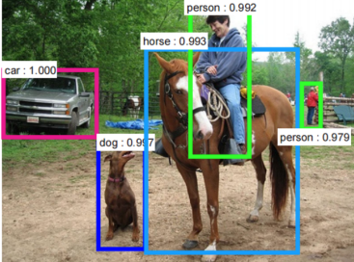
CNN
A type of Neural Networks.
Effective in areas like image recognition and classification.

Slide 8
CNN vs MLP
This Photo by Unknown Author is licensed under CC BY-NC-ND
Notes:
Consider a 28x28 MNIST image means 784 neurons, If I have 200 hundred neuron in First hidden layer means 784x200 = 156800
And at output we have to have 10 neurons (one for each digit), so total number of weights 156800+ 2000= 1,58,800 = One Lakh fifty eight thousand eight hundred!!!

Slide 9
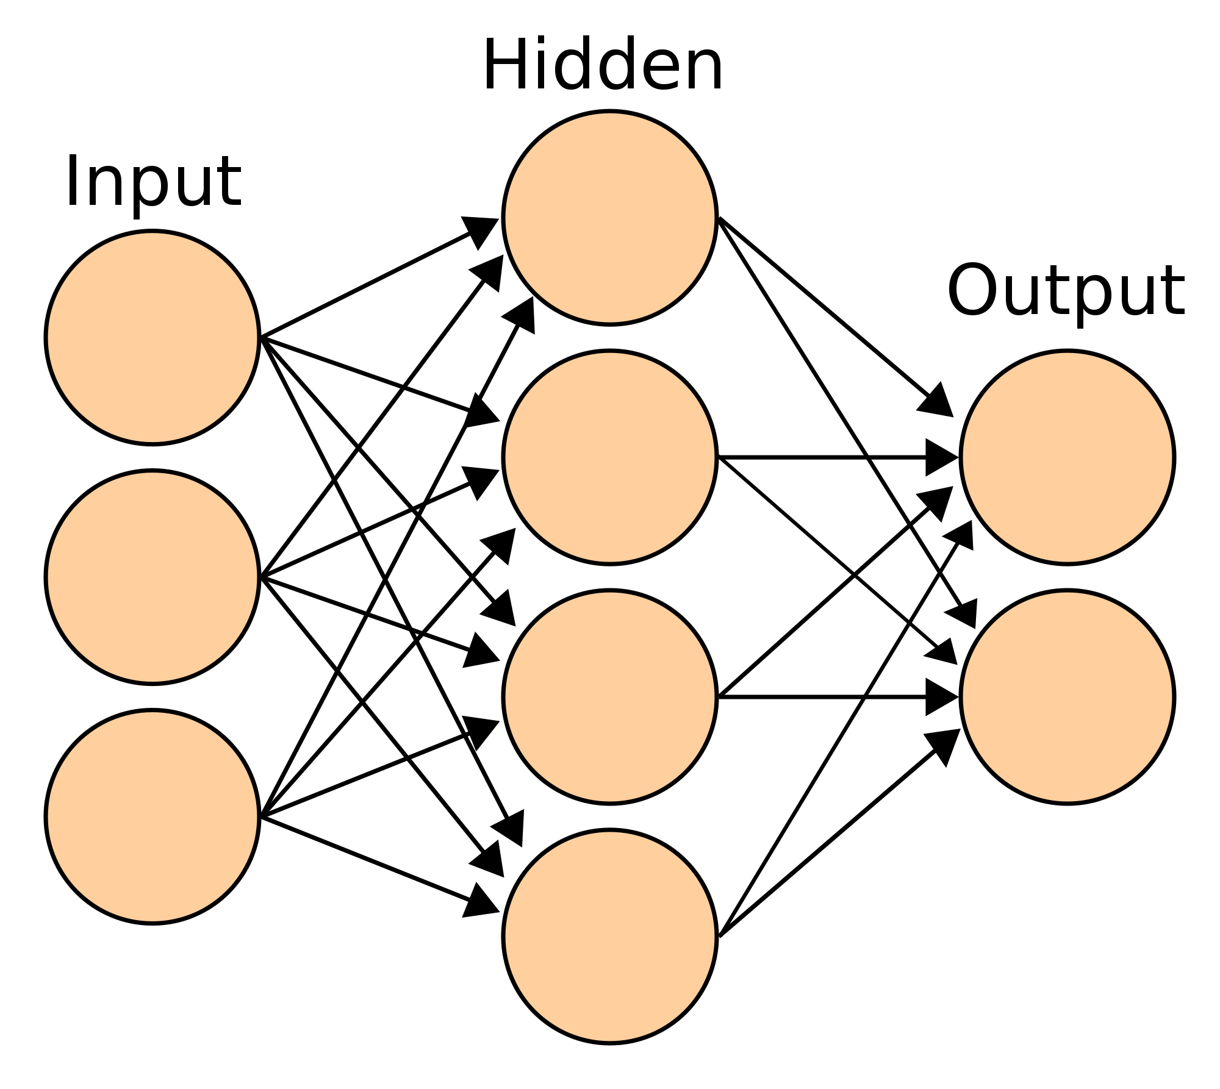
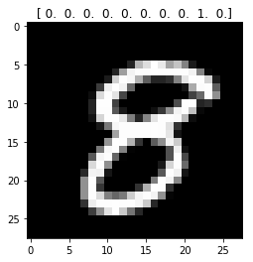
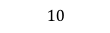

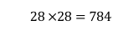
CNN vs MLP
MLP: Number of trainable parameters become extremely large
$$28 ×28=784$$
$$200$$
$$10$$
Notes:
Consider a 28x28 MNIST image means 784 neurons, If I have 200 hundred neuron in First hidden layer means 784x200 = 156800
And at output we have to have 10 neurons (one for each digit), so total number of weights 156800+ 2000= 1,58,800 = One Lakh fifty eight thousand eight hundred!!!

Slide 10
CNN vs MLP
MLP: Number of trainable parameters become extremely large
CNN: Little or no invariance to shifting, scaling etc.
$$28 ×28=784$$
$$200$$
$$10$$
Notes:
Consider a 28x28 MNIST image means 784 neurons, If I have 200 hundred neuron in First hidden layer means 784x200 = 156800
And at output we have to have 10 neurons (one for each digit), so total number of weights 156800+ 2000= 1,58,800 = One Lakh fifty eight thousand eight hundred!!!

Slide 11
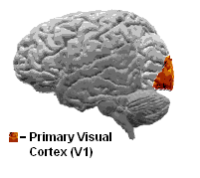
Convolutional Neural Network
Improvement over MLP
Inspired by organization of animal visual cortex
Hubel and Wiesel’s (1968) work on cat’s visual cortex.
Visual Cortex contains a complex arrangement of cells.
Cells sensitive to small sub regions of the visual field: Receptive Field
These sub-regions are tiled to cover the entire visual field.
Two basic cell types:
Simple cells: respond maximally to specific edges/patterns
Complex cells: have larger receptive fields and are locally invariant.
Notes:
Neocognitron also inspired from visual cortex.
So these cells in the Receptive fields they are acting as local filters over the input space. Thus good foe detecting the spatial correlation present in neural images.

Slide 12
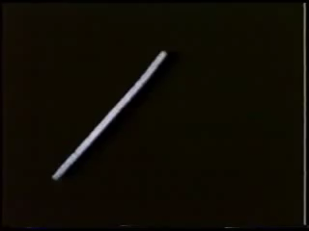

Slide 13
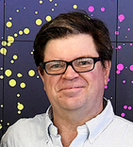
Convolutional Neural Network
Was proposed first by Yann LeCun in 1988 for the recognition of handwritten digits (MNIST).
Image Source: http://yann.lecun.com/

Slide 14
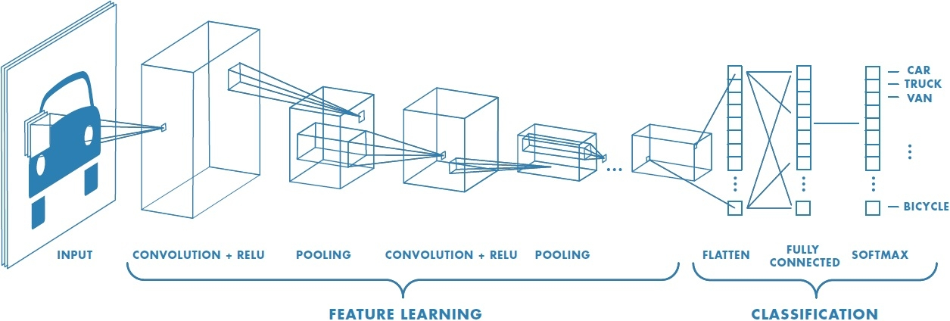
CNN
A feed forward network
They extract topological properties from an image.
Consists of multiples of convolution layer, ReLu Layer followed by Pooling layer.
Shared weights
Image Source: https://www.mathworks.com/discovery/convolutional-neural-network.html
Notes:
Data Augmentation is used to achieve Shift and rotation invariance

Slide 15
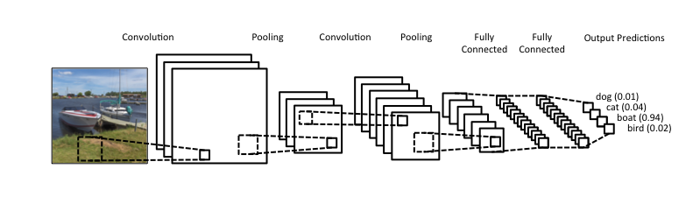
CNN-Architecture
CNN consists of four main parts:
Convolution
Non Linearity
Pooling
Classification
Image Source: https://www.clarifai.com/technology

Slide 16
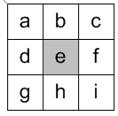
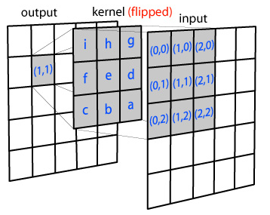
Convolution and filters
Convolution is an old signal processing trick
Process of adding each element of the image to its local neighbors, weighted by the kernel (filter).
Traditionally it involves flipping both the rows and columns of the kernel and then multiplying locally similar entries and summing.

Slide 17
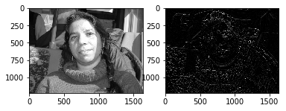
Convolution and filters
kernel = np.array([[ 1, 2, 1],
[ 0, 0, 0],
[-1, -2, -1]])
k2 = np.flip(np.fliplr(kernel),0)
filtered = cv2.filter2D(src=image, kernel=k2, ddepth=-1)
plt.subplot(121)
plt.imshow(image, cmap='gray')
plt.subplot(122)
plt.imshow(filtered, cmap='gray')

Slide 18
Convolution in CNN
No flip is needed
Image Source: http://ufldl.stanford.edu/tutorial/supervised/FeatureExtractionUsingConvolution/

Slide 19
Convolution in CNN
Convolution provides three important ideas that help improve machine learning systems
Sparse interactions: kernel smaller than input
Parameter sharing: The network has tied weights (shared)
Equivariant representations: parameter sharing causes equivariance to translation

Slide 20
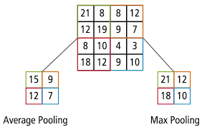
Average/Max Pooling

Slide 21
Stride and padding
Stride: the step of the convolution operation.
It defines the shift in filter on an image at each step.
When the stride is 1 then we move the filters one pixel at a time.
It is convenient to pad the input volume with zeros around the border.
The nice feature of zero padding is that it will allow us to control the spatial size of the output volumes.
Both stride and padding are hyperparameters

Slide 22
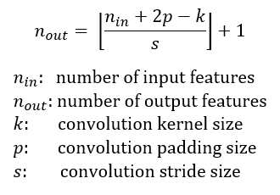
Stride and padding
The size of the output image is affected by stride size and by padding:

Slide 23
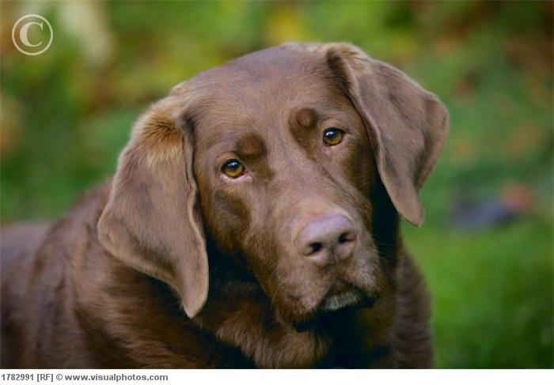
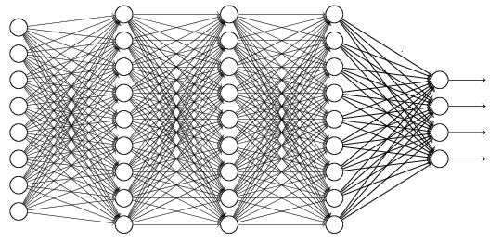
Cat/Dog …
Convolution
Max Pooling
Fully Connected Feedforward network
A new image
Convolution
Max Pooling
Flattened
A new image

Slide 24
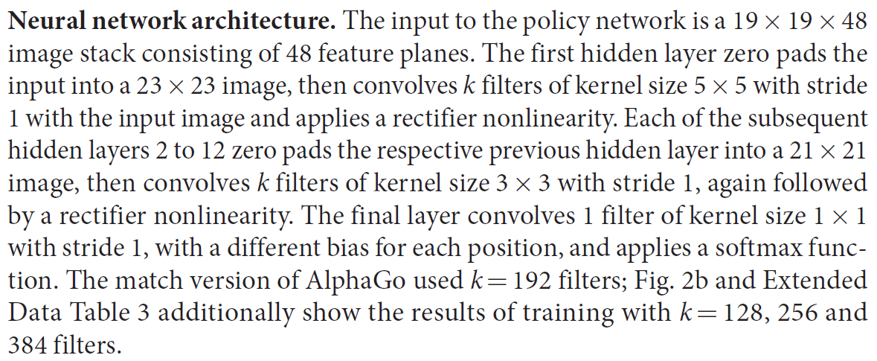
AlphaGo’s policy network
The following is quotation from their Nature article:
Note: AlphaGo does not use Max Pooling.

Slide 25
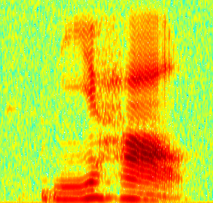
CNN in speech recognition
The filters move in the frequency direction.
CNN
Frequency
Image
Time
Spectrogram

Slide 26
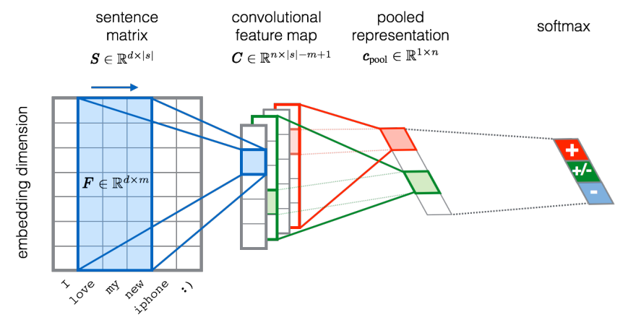
CNN in text classification
?
Source of image: http://citeseerx.ist.psu.edu/viewdoc/download?doi=10.1.1.703.6858&rep=rep1&type=pdf

Slide 27
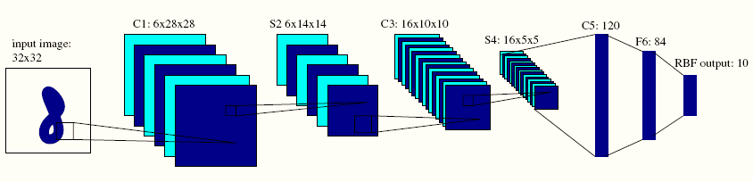
LeNet5
7 level CNN
Recognize handwritten digits on cheques

Slide 28
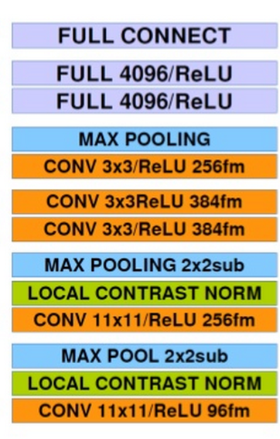
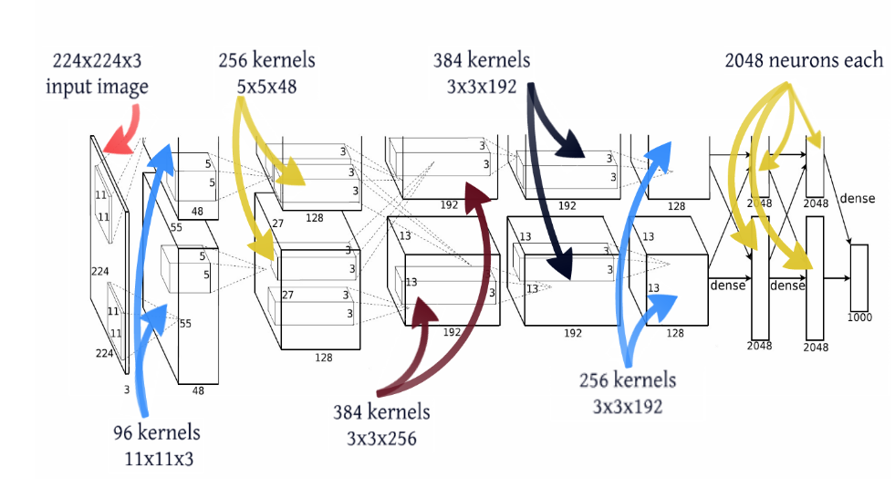
Alexnet
Developed by Alex Krizhevsky, Ilya Sustskever and Geoffrey Hinton.
Winner of ImageNet ILSVRC challenge 2012

Slide 29
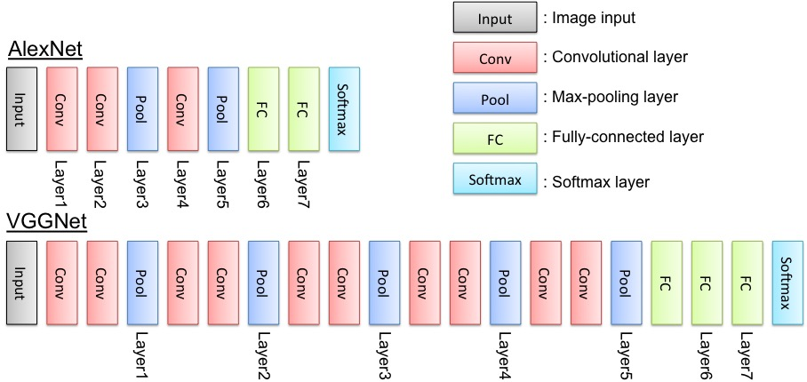
VGGNET
Runner Up ILSVRC 2014
Karen Simonyan and Andrew Zisserman
To handle convergence on this deep network -> They trained first smaller versions of VGG first, and then used them as initialization for the deeper network – Pre Training
VGG16 ~ 533MB
VGG19 ~ 574MB
Notes:
ILSVRC: Imagenet Large Scale Visual Recognition Challenge
VGG: Visual Geometry Group, University of Oxford
Nowadays instead of pre-training, Xavier or MSRA initializations are used for CNN

Slide 30
Inception
Winner ILSVRC 2014
GoogLeNet
Inception Module: Acts as multi-level feature extractor
Computes convolutions within the same module of the network.
The output of these filters are then stacked along the channel dimension, before being fed into the next layer.
Inceptionv3 ~ 96MB
Inspired by Inceptionv3- Xception by Franҫois Chollet
Notes:
Inception module is replaced by depth wise separable convolutions

Slide 31
ResNet
Network in Network
Just increasing layers is not sufficient.
So they modified the Architecture and introduced Residual Learning.
Inceptionv4
Latest in line: Combines Inception module with residual learning.

Slide 32
Overfitting
Occurs when a statistical model describes random error or noise instead of the underlying relationship
Exaggerate minor fluctuations in the data
Will generally have poor predictive performance

Slide 33
Reducing Overfitting
Data Augmentation
Image translation and horizontal reflection
Randomly extracting patches
Four corner and one center patches with reflection for testing
Altering the intensities of the RGB channels in training images
Approximately captures an important property of natural images
reduces the top-1 error rate by over 1%

Slide 34
Reducing Overfitting
Dropout
Zero the output of each hidden neuron with probability 0.5.
No longer contribute to forward pass and backward propagation
Neural network samples a different architecture every time
Reduce complex co-adaptations of neurons
Used in two fully-connected layers

Slide 35
Disadvantages
From a memory and capacity standpoint the CNN is
not much bigger than a regular two layer network.
At runtime the convolution operations are
computationally expensive and take up about
67% of the time.
CNN’s are about 3X slower than their fully connected equivalents (size-wise).

Slide 36
What is Transfer Learning?
Transfer knowledge to new conditions.
Reuse of some or all of the training (data) of a prior model:
feature representations
neural-node layering
Weights
training method
loss function
learning rate etc.
Tap into the knowledge gained on prior projects: Supervised, Unsupervised, Reinforcement Learning
Extracts knowledge from one or more source tasks and apply the knowledge to a target task.

Slide 37
What is Transfer Learning?
Transfer knowledge to new conditions.
Reuse of some or all of the training (data) of a prior model:
feature representations
neural-node layering
Weights
training method
loss function
learning rate etc.
Tap into the knowledge gained on prior projects: Supervised, Unsupervised, Reinforcement Learning
Extracts knowledge from one or more source tasks and apply the knowledge to a target task.

Slide 38
What is Transfer Learning?
People can intelligently apply knowledge learned previously to solve new problems.
Not a new concept:
NIPS-95 Learning to Learn: Need for lifelong machine learning methods that retain and reuse previously learned knowledge.
DARPA 2005: The ability of a system to recognize and apply knowledge and skills learned in previous task to novel tasks.

Slide 39
Transfer Learning
Transfer learning will become a key driver of Machine Learning success in industry.
-Andrew Ng (NIPS 2016)

Slide 40
Transfer Learning- ML Commercial Success-Key?
Traditional Models have reported Super human performance in certain tasks.
Yet, when they are used in production, the performance deteriorates.
Real world is very different from the structured data used for training and testing.
Individual users can have slightly different preferences.
Transfer Learning can help deal with these and allow us to use ML beyond tasks and domains where
labelled data is plentiful,
data is outdated
Boost productivity by reducing time to implement new projects

Slide 41
Applications of Transfer Learning
Learning from simulations and then applying to real world:
Real world data is hard to come by. Generate data using simulator: Data has similar feature space, slightly different in marginal probability distributions, and different in conditional probability distributions.
E.g.: Self driving Car, Robots, AGI Agents
Data becoming outdated:
Wi-Fi Localization: Locating a mobile device in an indoor environment, position of device changes
Sentiment Classification:
Learn sentiment classification on one topic and apply the model learned on other topics
Cross Domain Activity Recognition
Knowledge about activity learned in one domain (Cleaning Indoor) can be applied to other domain (Doing Laundry).

Slide 42
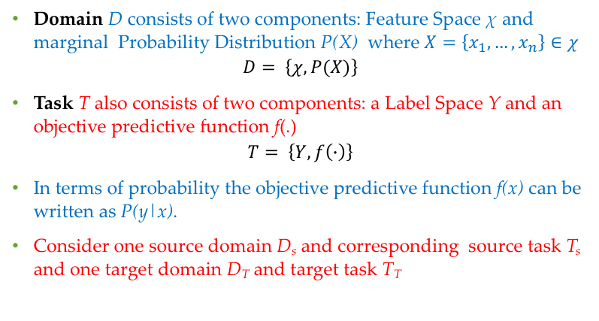
Transfer Learning: Formal Definition¹
Domain D consists of two components: Feature Space χ and marginal Probability Distribution P(X) where $X=\left\{x_{1},…,x_{n}\right\}∈χ$
$$D= \left\{χ, P(X)\right\}$$
Task T also consists of two components: a Label Space Y and an objective predictive function f(.)
$$T= \left\{Y, f\left(∙\right)\right\}$$
In terms of probability the objective predictive function f(x) can be written as P(y|x).
Consider one source domain D_{s} and corresponding source task T_{s} and one target domain D_{T} and target task T_{T}
Notes:
F() is learned from the training data which consists of pairs $\left\{x_{i}, y_{i}\right\} where xi belongs to X and yi belongs to Y. f can be used to preduct f\left(x\right), the corresponding label of a new instance x.$
F(x) = P(y|x)

Slide 43
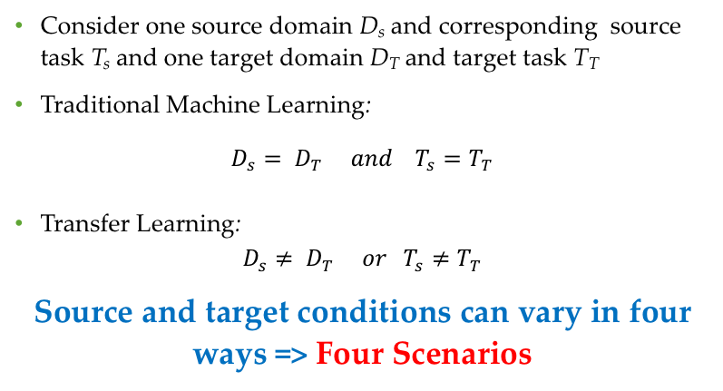
Transfer Learning: Formal Definition¹
Consider one source domain D_{s} and corresponding source task T_{s} and one target domain D_{T} and target task T_{T}
Traditional Machine Learning:
$$D_{s}= D_{T} and T_{s}=T_{T}$$
Transfer Learning:
$$D_{s}≠ D_{T} or T_{s}≠T_{T}$$
Source and target conditions can vary in four ways => Four Scenarios
Notes:
F() is learned from the training data which consists of pairs $\left\{x_{i}, y_{i}\right\} where xi belongs to X and yi belongs to Y. f can be used to preduct f\left(x\right), the corresponding label of a new instance x.$
F(x) = P(y|x)

Slide 44
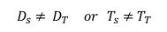

Traditional vs Transfer Learning
$$D_{s}= D_{T} and T_{s}=T_{T}$$
$$D_{s}≠ D_{T} or T_{s}≠T_{T}$$
Domain/Task A
Domain/Task B
Domain/Task A
Domain/Task B
Model A
Model B
Model
Model
Knowledge
Training and Evaluation on same task/domain
Training and Evaluation on same task/domain

Slide 45
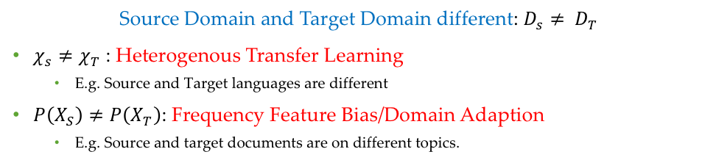
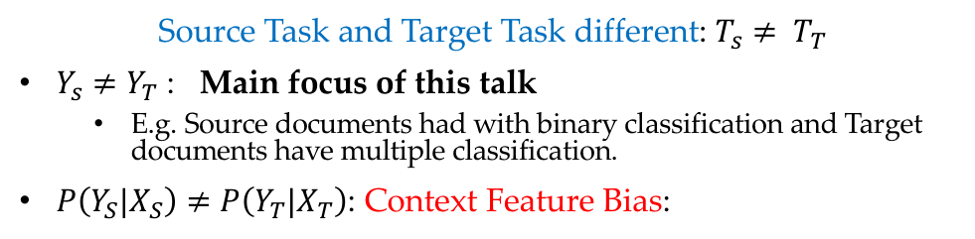
Transductive Transfer Learning
Source Domain and Target Domain different: $D_{s}≠ D_{T}$
$χ_{s}≠χ_{T}$ : Heterogenous Transfer Learning
E.g. Source and Target languages are different
$P\left(X_{S}\right)≠P\left(X_{T}\right)$: Frequency Feature Bias/Domain Adaption
E.g. Source and target documents are on different topics.
Inductive Transfer Learning
Source Task and Target Task different: $T_{s}≠ T_{T}$
$Y_{s}≠Y_{T}$ : Main focus of this talk
E.g. Source documents had with binary classification and Target documents have multiple classification.
$P\left(Y_{S}{|X}_{S}\right)≠P\left({Y_{T}|X}_{T}\right)$: Context Feature Bias:
Notes:
$χ_{s}≠χ_{T}$ : Heterogenous Transfer Learning
E.g. Text classification: Source and Target languages are different
Use either a symmetric Transformation or an asymmetric transformation process to resolve the difference between feature space.
$P\left(X_{S}\right)≠P\left(X_{T}\right)$: Frequency Feature Bias/Domain Adaption
E.g. Text classification: Source and target documents are on different topics.
Augment the feature space; Discover common latent features that have the same marginal distribution [Chen, 2012].

Slide 46


Transfer Learning Approach
Instance based approach:
Source and target domains have lot of overlapping features
Parameter-based approach
Relational Approach
Feature-based approach:
Source and target have some overlapping features
$$χ_{s}$$
$$χ_{T}$$

Slide 47


Transfer Learning Approaches
Instance based approach:
Source and target domains have lot of overlapping features
Feature-based approach:
Source and target have some overlapping features
Parameter-based approach
Relational Approach
$$χ_{s}$$
$$χ_{T}$$
$$χ_{s}$$
$$χ_{T}$$

Slide 48

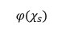
Transfer Learning Approaches
Instance based approach:
Source and target domains have lot of overlapping features
Feature-based approach:
Source and target have some overlapping features
Parameter-based approach
Relational Approach
$$χ_{s}$$
$$χ_{T}$$
$${φ(χ}_{s})$$
$${φ(χ}_{T})$$

Slide 49
Transfer Learning Approaches
Instance based approach:
Source and target domains have lot of overlapping features
Feature-based approach:
Source and target have some overlapping features
Parameter-based approach: Source and target tasks are related, and so what has been learned from source can be transferred to target.
Relational Approach
$$χ_{s}$$
$$χ_{T}$$
$${φ(χ}_{s})$$
$${φ(χ}_{T})$$

Slide 50
Transfer Learning Approaches
Instance based approach:
Source and target domains have lot of overlapping features
Feature-based approach:
Source and target have some overlapping features
Parameter-based approach: Source and target tasks are related, and so what has been learned from source can be transferred to target.
Relational Approach:
If two relational domains are related, they may share similar relations among Objects.
$$χ_{s}$$
$$χ_{T}$$
$${φ(χ}_{s})$$
$${φ(χ}_{T})$$

Slide 51
Transfer Learning Techniques
Using pre-trained models: Useful when new task has different label space.
Training an entire convolutional neural network from scratch requires a very large dataset and time, instead use a pretrained CNN
Learn domain-invariant representations: Useful for Heterogenous transfer learning and Domain Adaptation.
Use models to learn representations that do not change based on the domain: Find a Common Latent Feature Space. Use Denoised Autoencoders
Make representations more similar
Pre-process such that representations of both domains become more similar to e/o
Domain Confusion
Add an objective function to existing model that confuses the two domains.

Slide 52
Pre-trained Models
Pre-trained CNN as feature extractor:
Take a pre-trained CNN model, remove the last fully connected layers, use the remaining CNN as feature extractor for the new dataset. The output of this CNN feature extractor is fed to a classifier. The classifier is trained for the new dataset.
Fine tune pre-trained CNN:
The weights of both the pre-trained CNN layers (all or some) and fully connected classifier layer/s are fine tuned using backpropagation.

Slide 53
Which method to employ?
Train the network from scratch
Fine Tune the whole network
Target Dataset Size
Freeze the initial layers (n) of pre-trained CNN, train the remaining layers.
In CNN initial layers capture low-level image features, while top layers capture complex details.
Use pre-trained CNN as feature extractor, train only the fully connected layers.
Source-Target Feature Similarity

Slide 54
Pre-trained Models in Keras/Tensorflow
Models for Image classification with weights trained on ImageNet
Xception
VGG16
VGG19
ResNet50
InceptionV3
MobileNet
Import Models:
from keras.applications.model_name import model_name
From keras.applications.model_name import preprocess_input, decode_predictions
from keras.applications.vgg16 import VGG16

